Slide 1


Feature detection and matching with OpenCV-Python

Slide 2
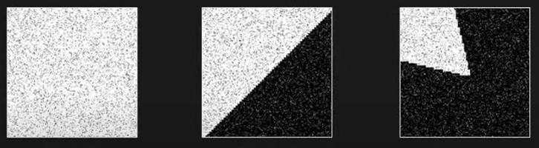
What is Feature Matching?
Feature matching involves identifying and aligning corresponding features across multiple images.
Features refer to distinctive elements in an image, such as edges, corners, that can be consistently detected and described. By matching these features, computer vision systems can recognize objects, track movement, create panoramic images, and reconstruct 3D scenes from 2D images.

Slide 3
What is Feature Matching?
Feature matching is a fundamental technique in computer vision that involves identifying and aligning corresponding features across multiple images. Features refer to distinctive elements in an image, such as edges, corners, that can be consistently detected and described. By matching these features, computer vision systems can recognize objects, track movement, create panoramic images, and reconstruct 3D scenes from 2D images.

Slide 4
Key Aspects of Feature Matching
Some of the common applications are:
Feature Detection
Feature Description

Slide 5
Key Aspects of Feature Matching
Feature Detection:
The process begins by detecting key features in each image. These features are typically points of interest that are easy to distinguish, such as corners or edges.
Common feature detectors include Harris Corner Detector, Laplacian of Gaussian for blob detection, and Canny Edge Detector.

Slide 6
Key Aspects of Feature Matching
Feature Description:
Once features are detected, they are described using feature descriptors, which provide a numerical representation of the feature's characteristics.
Popular feature descriptors include SIFT (Scale-Invariant Feature Transform), SURF (Speeded Up Robust Features).

Slide 7
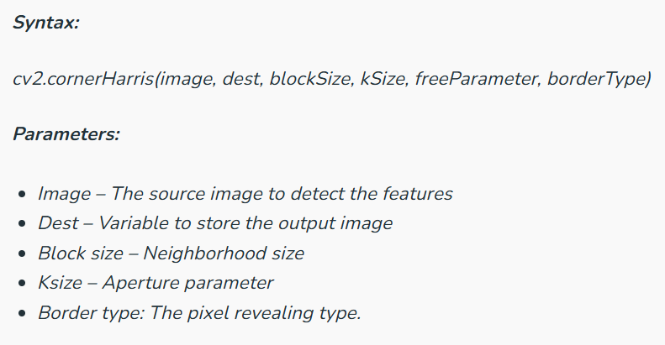
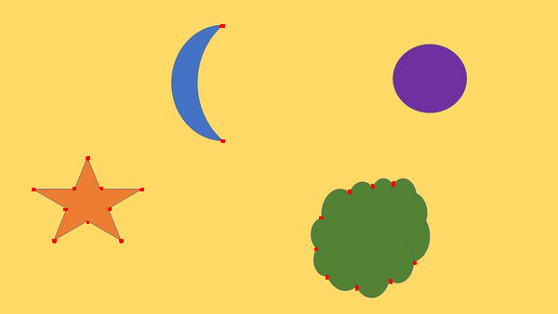
Haris corner detection
Haris corner detection is a method in which we can detect the corners of the image by sliding a slider box all over the image by finding the corners and it will apply a threshold and the corners will be marked in the image. This algorithm is mainly used to detect the corners of the image.

Slide 8
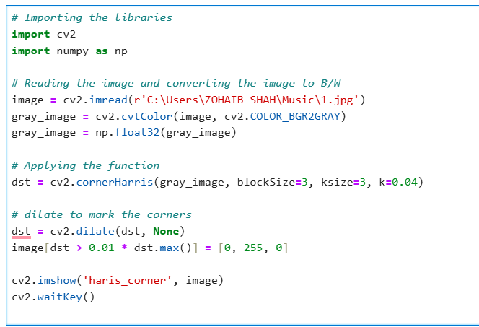
Implementation & OpenCV Functions:

Slide 9
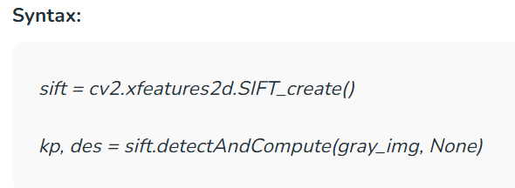
SIFT (Scale-Invariant Feature Transform)
SIFT is one of the important algorithms that detect objects irrelevant to the scale and rotation of the image and the reference. This helps a lot while we are comparing the real-world objects to an image though it is independent of the angle and scale of the image. This method will return the key points of the images which we need to mark in the image.

Slide 10
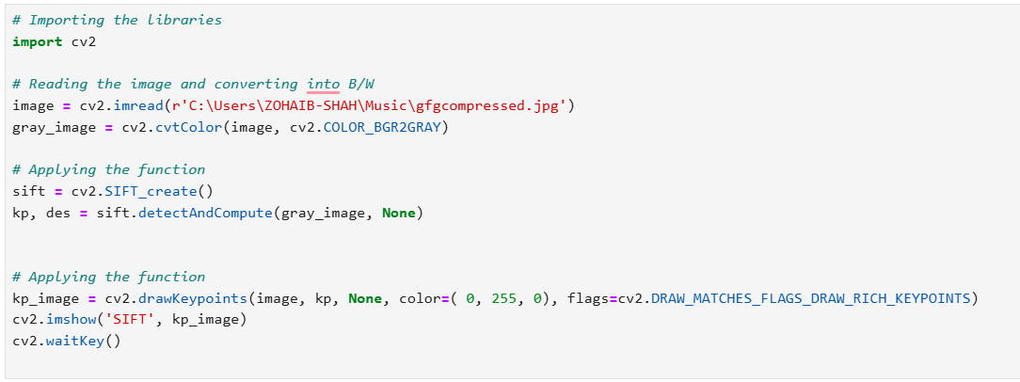
Implementation & OpenCV Functions:

Slide 11
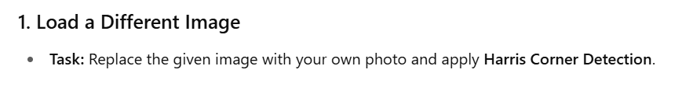
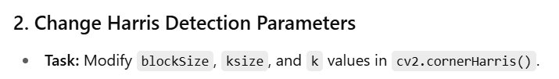
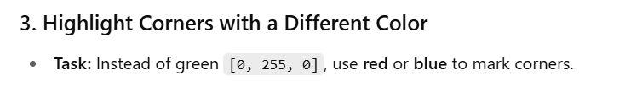
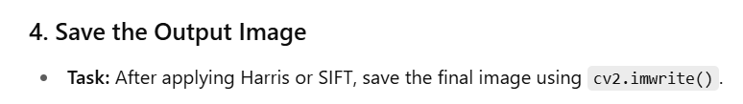
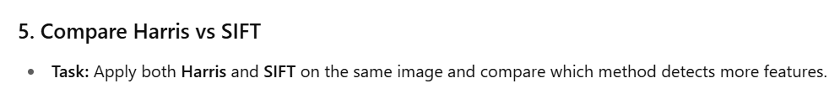
Tasks to Do.

Slide 12
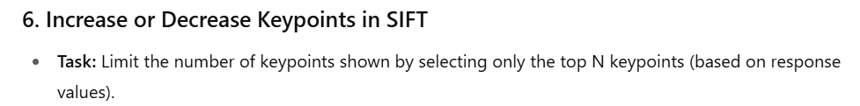
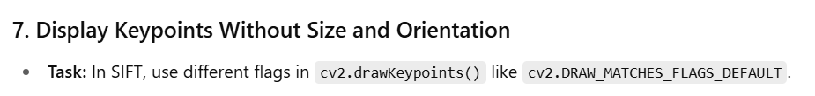
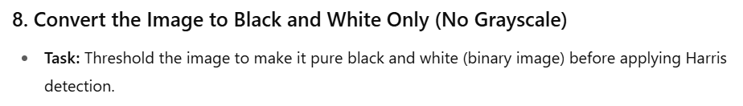
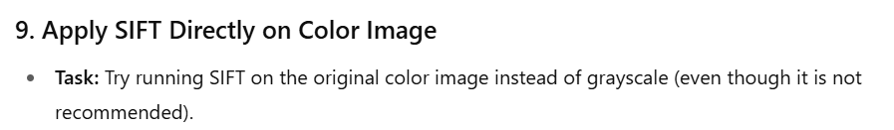
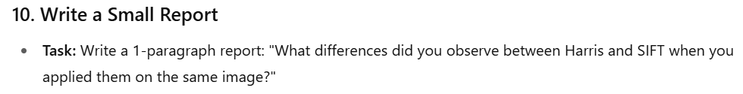
Tasks to Do.

